Slide 1

Enhancing usability and compliance through an a11y workflow

Slide 2

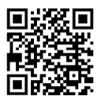
Rodney Wormsbecher
https://www.linkedin.com/in/rocodemy

Slide 3
Who has ever dealt with accessibility on web products?
Visually impaired and blind users
Cognitive disabled users.
Users suffering from epilepsy.
Limb loss users.

Slide 4
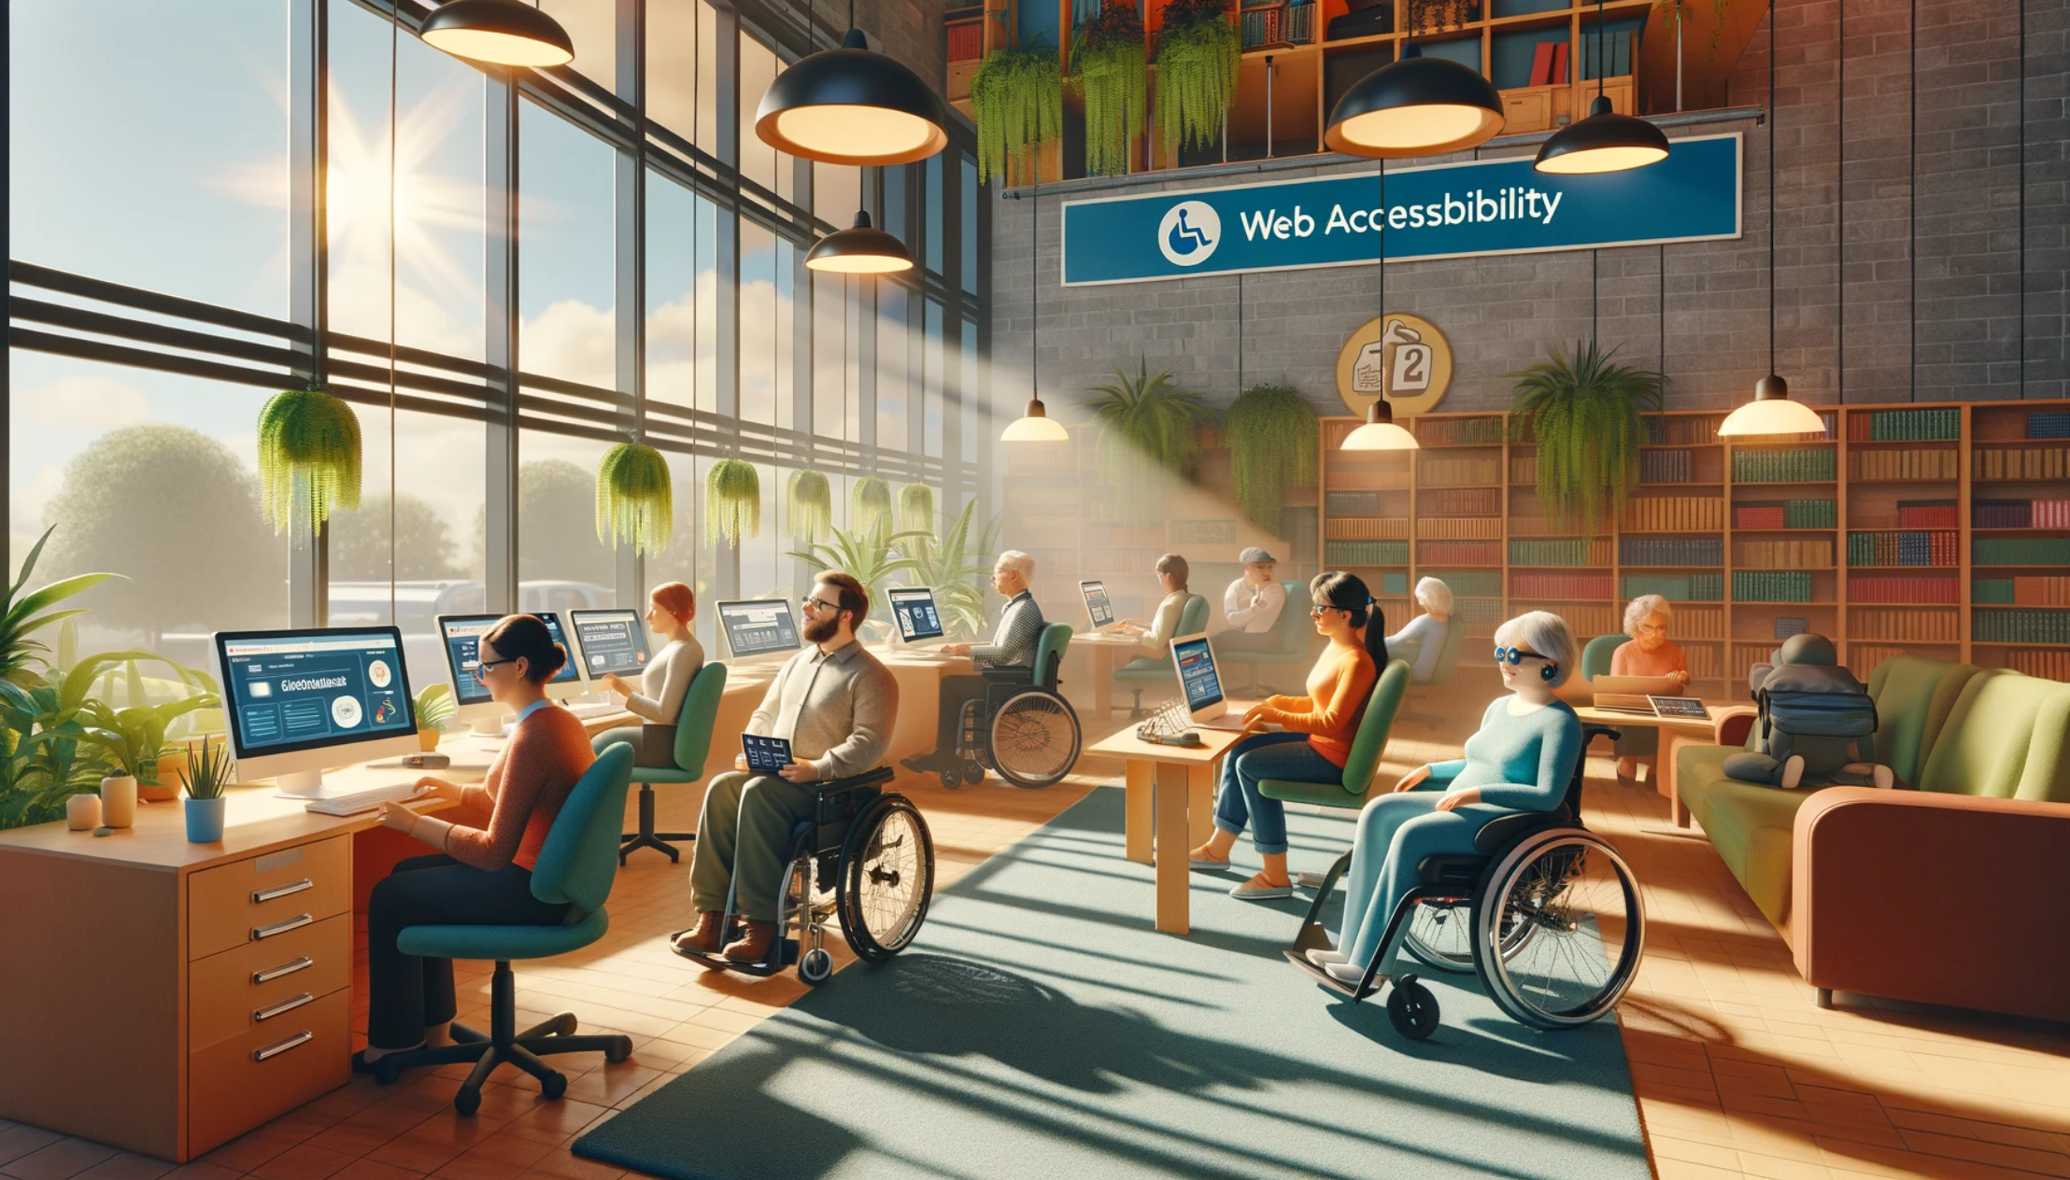

Slide 5


Slide 6
Which industries will be affected?
The EEA uses the WCAG guidelines for rules companies should adhere. Currently it states that companies should adhere to WCAG 2.2 level AA.
https://www.w3.org/TR/WCAG22/
https://www.w3.org/WAI/WCAG22/quickref/?currentsidebar=%23col_customize

Slide 7
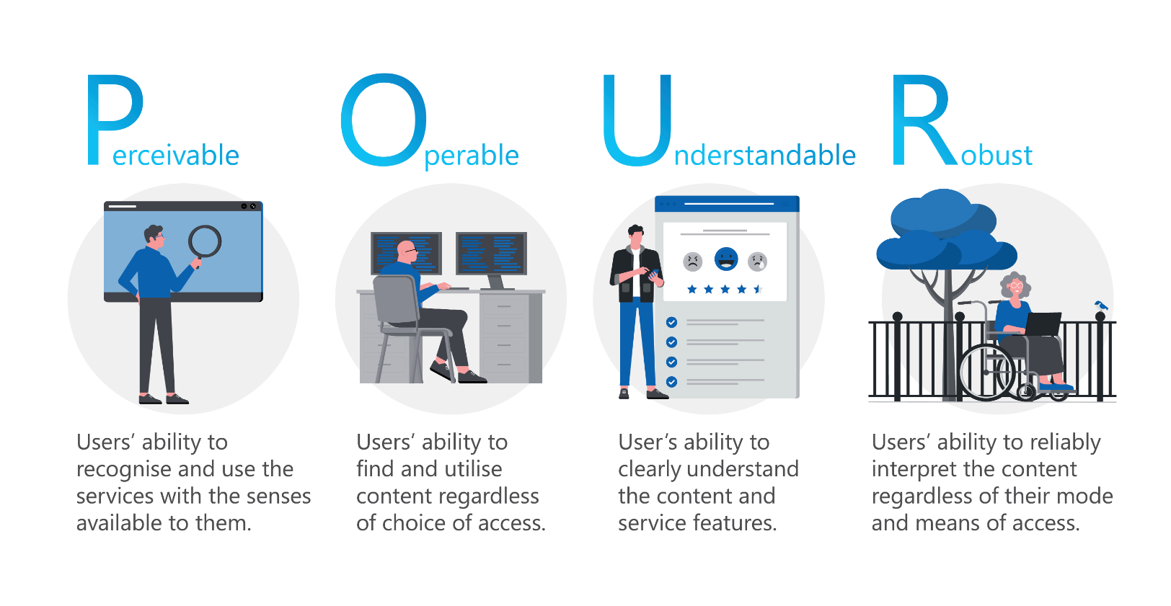

Slide 8
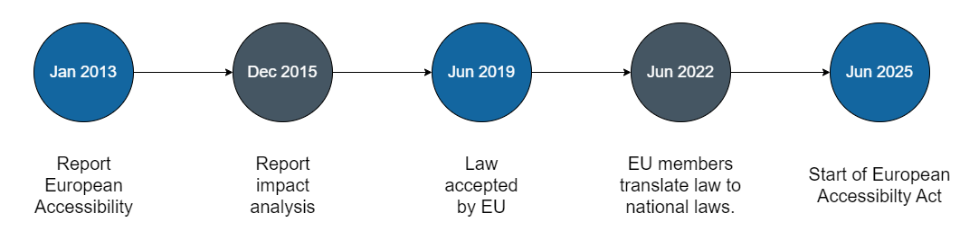
2013 report: https://ec.europa.eu/social/BlobServlet?docId=14840&langId=en
2015 report: https://eur-lex.europa.eu/legal-content/NL/TXT/HTML/?uri=CELEX:52015SC0265&from=EN

Slide 9
Which industries will be affected?
News and media
Product and services
Platforms with advertisements
Professional services
Entertainment
telecommunications

Slide 10
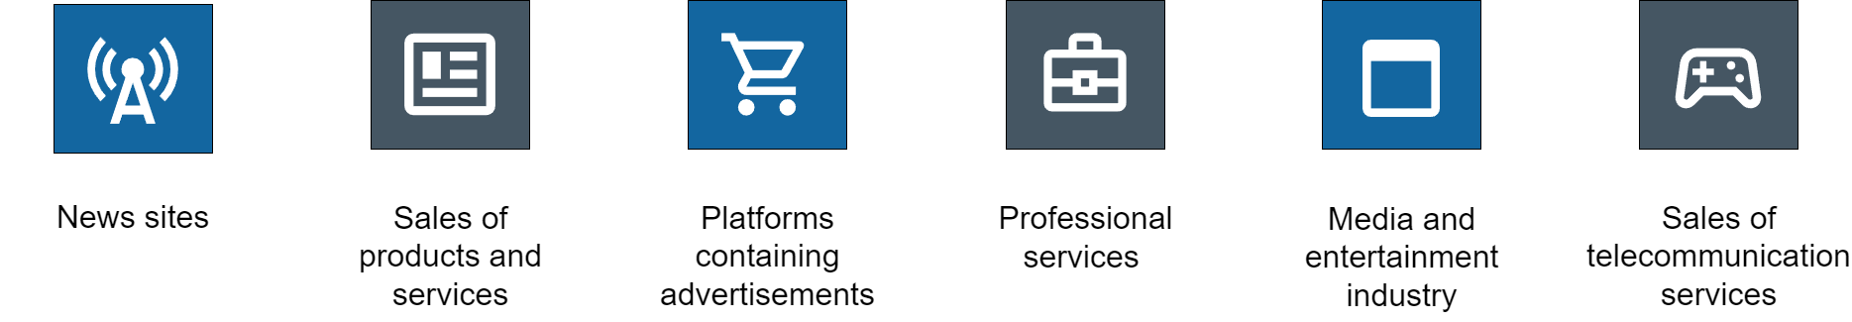

Slide 11
Exemptions
There is however an exemptions for small businesses. Your company is considered a small business if it has neither:
More than 2 million turnover.
More than 10 employees.

Slide 12
Enforcement
The European Commission will enforce the law through representatives in all 27 EU countries. In the Netherlands it will be enforces by 6 bodies including AFM and ACM.

Slide 13
Sanctions
When a company doesn’t comply with EEA it will be held accountable to:
Pay a fine.
Remediate the problem of inaccessibility.

Slide 14
Making web products accessible

Slide 15
A11y tools
In a moment we will use 4 tools to measure accessibility in a way that we can cover most of the issues.
Arc toolkit
Chromevox screenreader
Jest-axe
ChatGPT

Slide 16
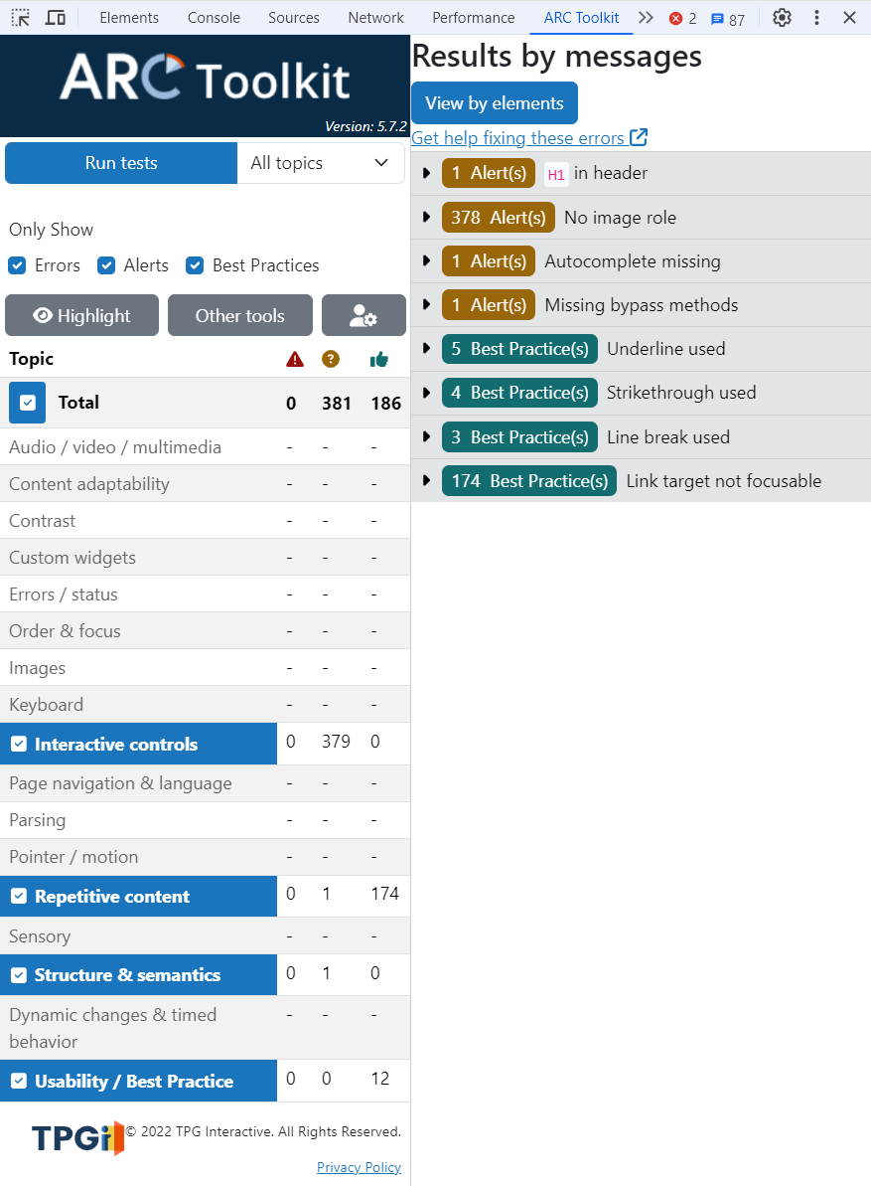
Arc toolkit
Quickly uncover and resolve accessibility issues on any web page with TPGi’s single-page, on-demand, accessibility testing tool. https://www.tpgi.com/arc-platform/arc-toolkit/

Slide 17

ChromeVox screen reader
The Chrome Screen reader extension is a showcase of a fully featured screen reader for the web built using only web technologies such as html and javascript. ChromeVox screen reader

Slide 18
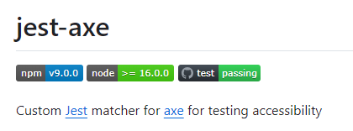
Jest-axe
Custom Jest matcher for axe for testing accessibility Jest-axe package

Slide 19

Chat-GPT
ChatGPT is a chatbot and virtual assistant developed by OpenAI and launched on November 30, 2022. Based on large language models, it enables users to refine and steer a conversation towards a desired length, format, style, level of detail, and language https://chatgpt.com

Slide 20
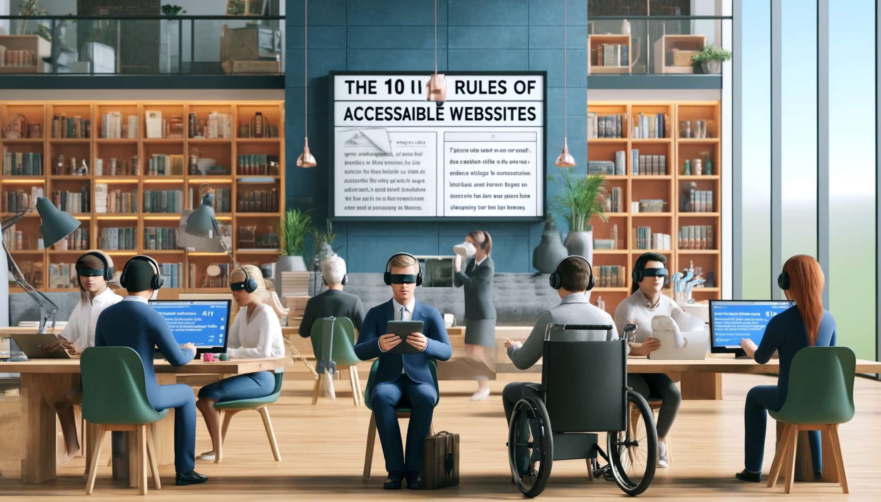
The 10 rules of accessibility
In the coming slides we will take a look for the

Slide 21
1 Use semantic HTML
Use proper HTML5 tags to differentiate layout elemens like: <header>, <main>, <article>, <section>, <footer>, and <nav>
Use proper headings and text elements to create a logical hierarchy of content. <h1>, <h2>, <h3>, <p>, <em>, <sup>

Slide 22
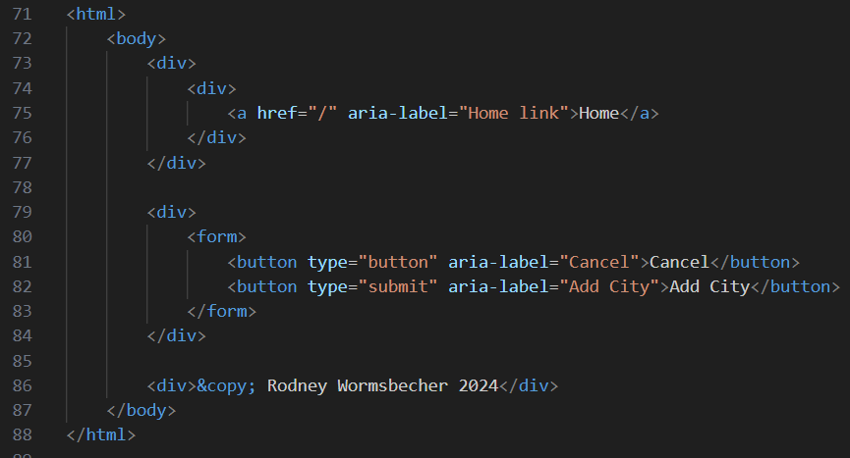

Slide 23
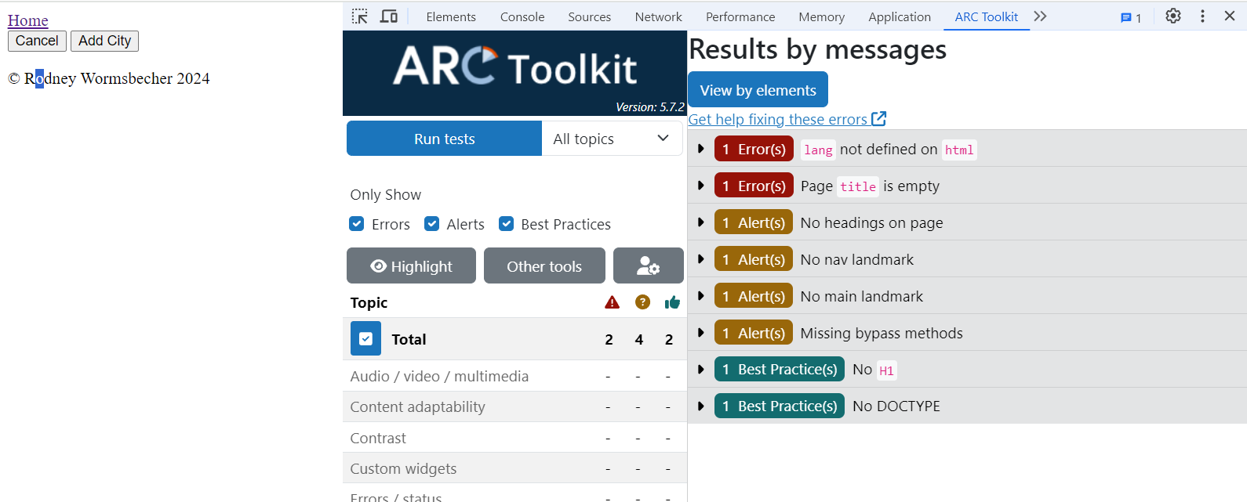
What’s wrong with this semantics.

Slide 24
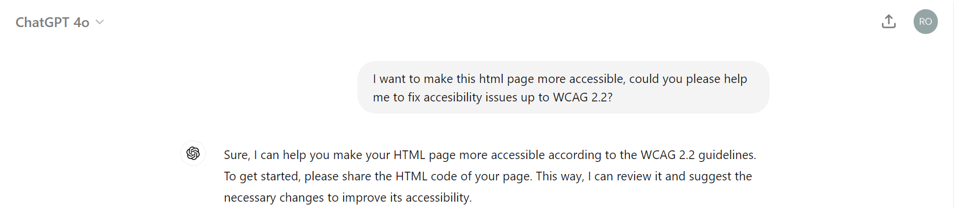
What’s wrong with this semantics.
Prompt: I want to make this html page more accessible, could you please help me to fix accessibility issues up to WCAG 2.2?

Slide 25
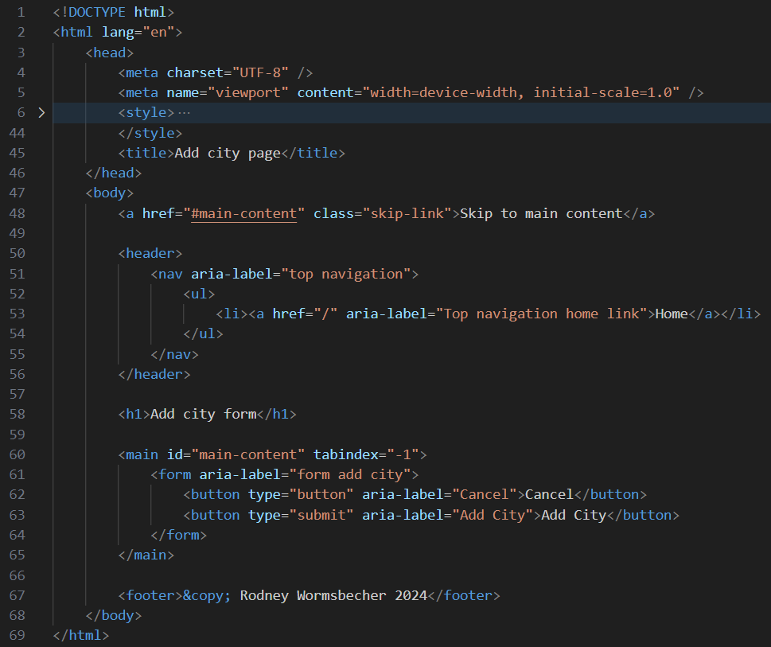

Slide 26
2 Provide text equivalents
Use descriptive alt texts to describe images
Make sure you either provide transcripts or captions for video and audio.

Slide 27
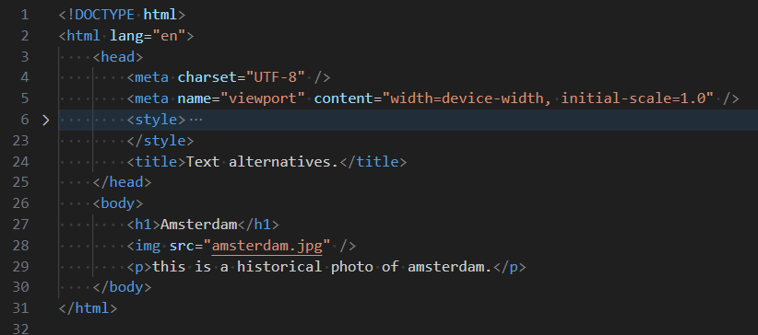

Slide 28
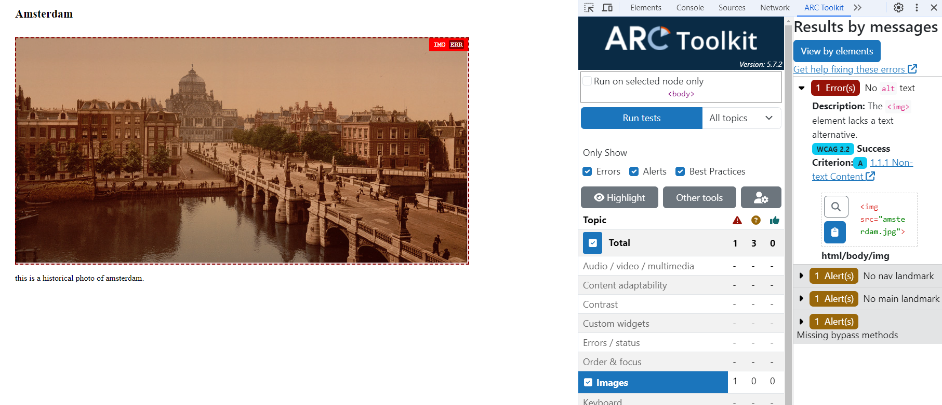
Provide text alternatives.

Slide 29
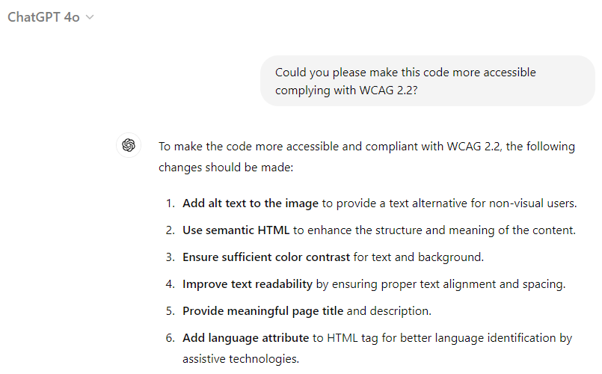
What’s wrong with this semantics.
Prompt: Could you please make this code more accessible complying with WCAG 2.2?

Slide 30
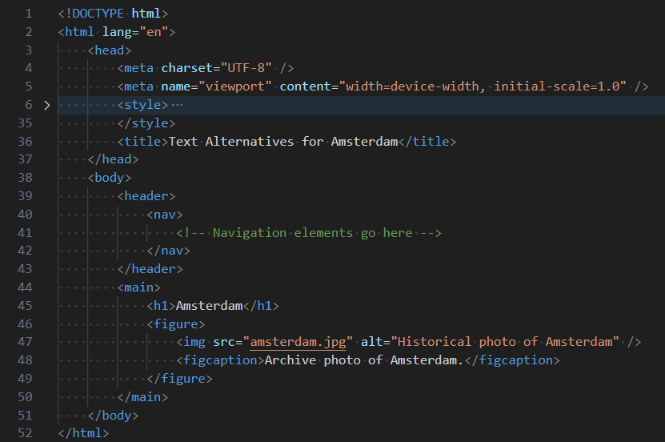

Slide 31
3 Keyboard accessibility and focus
Ensure all interactive elements (links, buttons, form fields) are accessible via keyboard navigation ([tab key] or [shift] + [tab]).
Use CSS to highlight currently focussed elements via ‘:focus-visible’, ‘outline’ or ‘border’ properties.

Slide 32
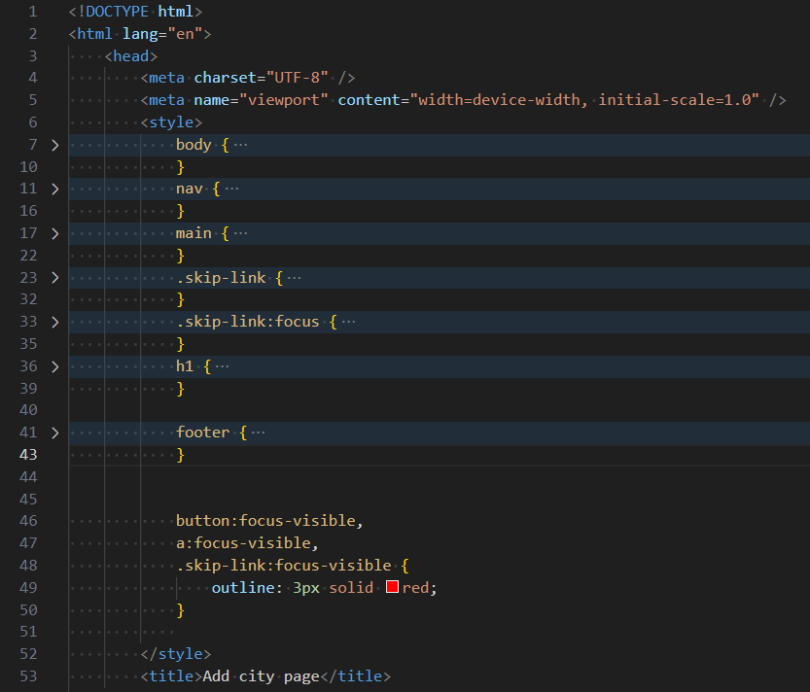

Slide 33
4 Use ARIA roles and landmarks
Use ARIA roles to enhance the accessibility of dynamic content and complex areas. For example, role="navigation" for navigation menus.
Provide ARIA labels to give additional context to elements (e.g., aria-label="Main Menu"), but only if there is no HTML5 element available.
https://developer.mozilla.org/en-US/docs/Web/Accessibility/ARIA/Roles/navigation_role

Slide 34
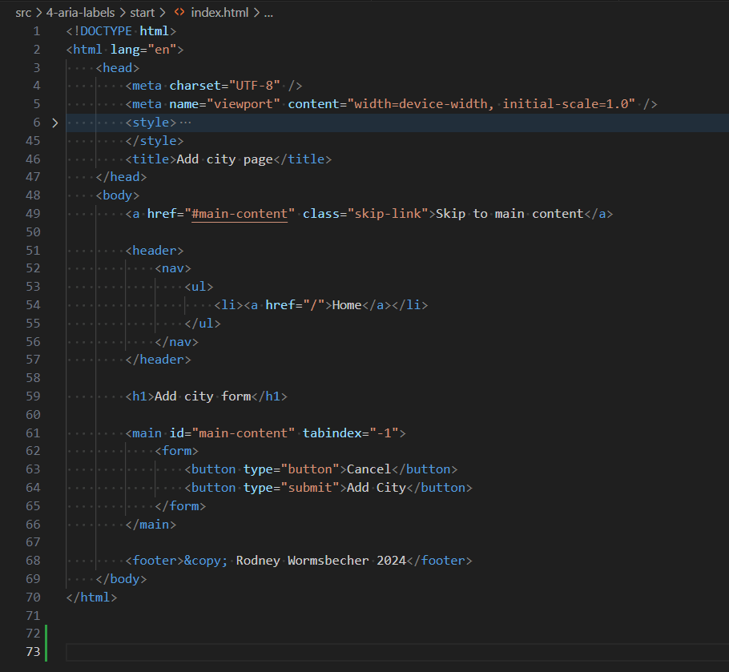

Slide 35
4 Use ARIA roles and landmarks
Even though the page already is fully compliant with WCAG 2.2 we can still improve a lot for screen readers with ARIA-WAI attributes.

Slide 36
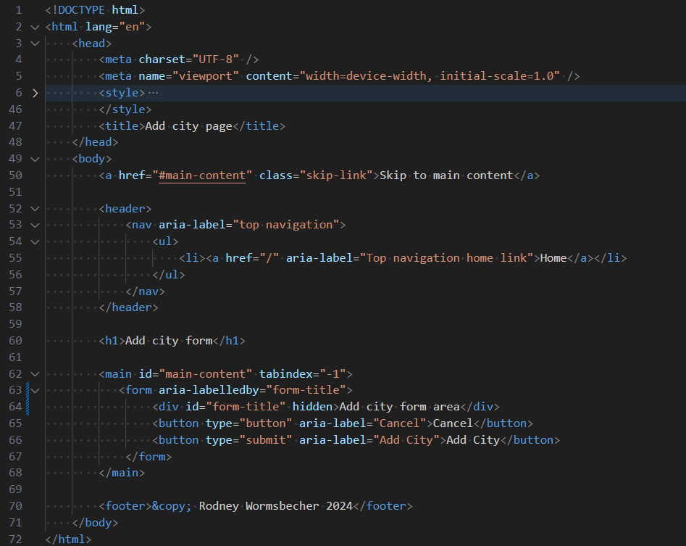

Slide 37
5 Color contrasts
Ensure the contrast ratio between text and background is sufficient. (minimum 4.5:1 for normal text, 3:1 for large text)
Make sure to not rely only on color to convey important information. Use text or symbols as well.

Slide 38
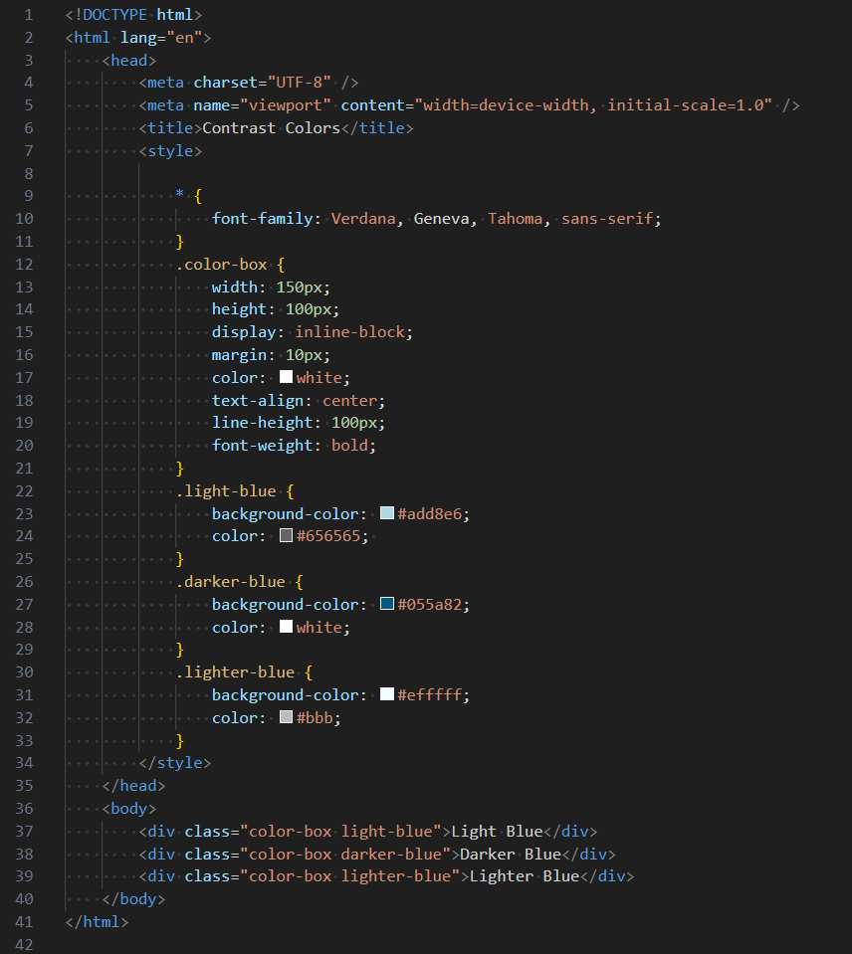

Slide 39
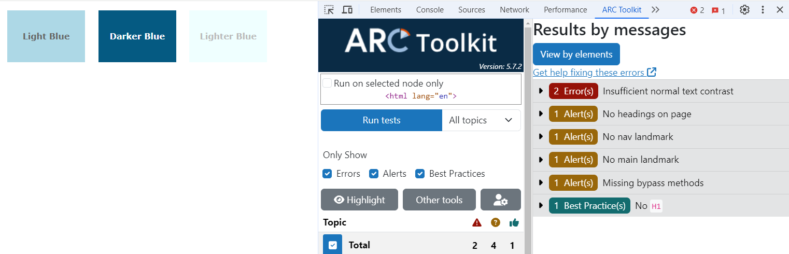
5 Color contrasts

Slide 40
5 Color contrasts
We can use ChatGPT to easily help us to calculate a 5:1 contrast for any color. Let’ look at it in action.

Slide 41
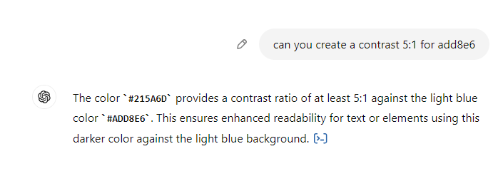
5 Color contrasts
Prompt: Can you create a contrast 5:1 for efffff

Slide 42
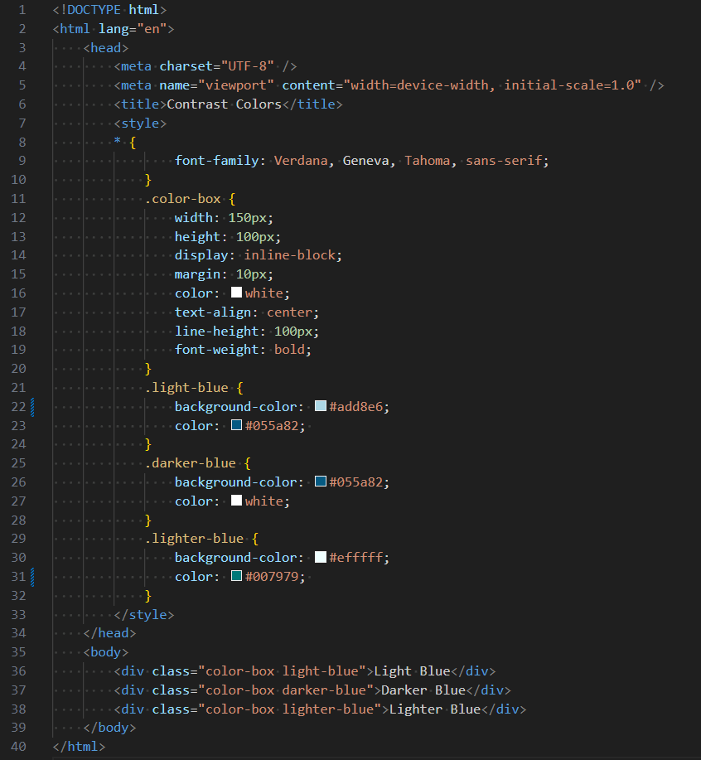

Slide 43
6 Make forms accessible
Associate every form element with a <label> tag
Provide clear instructions and error messages.

Slide 44
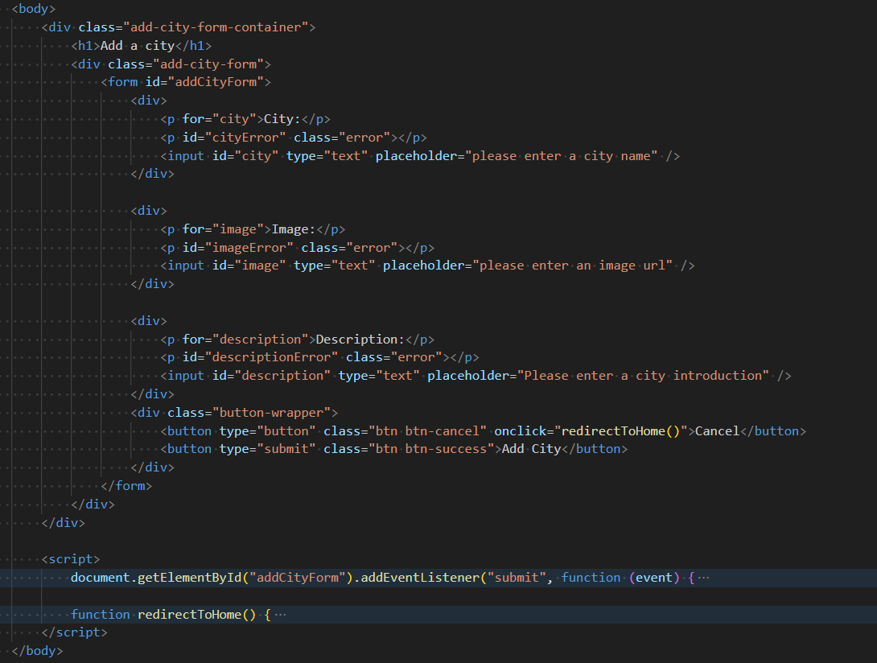

Slide 45
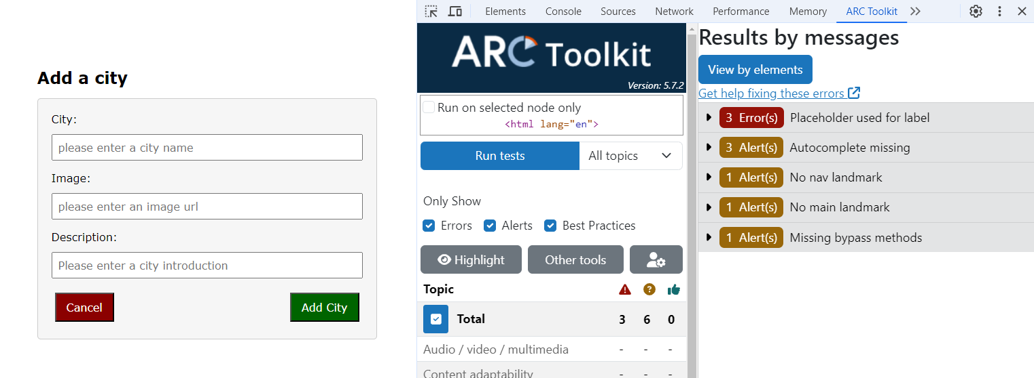
6 Make forms accessible

Slide 46
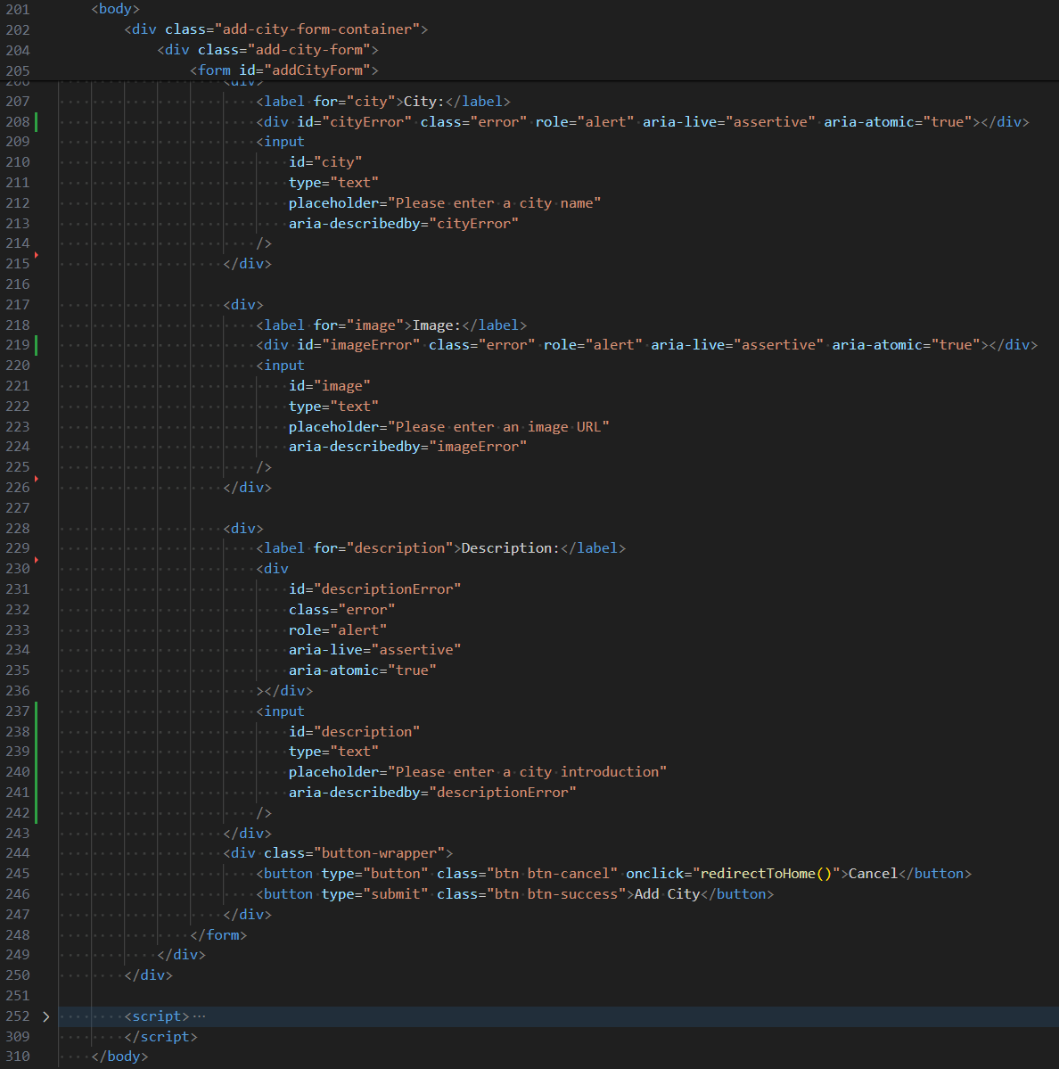

Slide 47
7 Responsive Design
Ensure your website is responsive and works well on various devices and screen sizes. Ensure content is accessible and functional when zoomed up to 200%.

Slide 48
8 Test with screen readers
Regularly test your website with screen readers like NVDA, JAWS, or VoiceOver to ensure content is accessible. Use offscreen text (e.g., position: absolute; left: -9999px;) to provide additional context for screen reader users without displaying it visually.

Slide 49
9 Avoid Time-Based Media
Provide users with control over time-based media (e.g., the ability to pause, stop, and adjust the volume) Avoid or provide options to extend time limits.

Slide 50
10 Continuous Testing and Improvement
Use accessibility evaluation tools like Axe, WAVE, or Lighthouse to identify and fix issues. Collect feedback from users with disabilities to continuously improve accessibility. E.g. GATT tests.

Slide 51
11 Jest-axe
Jest-axe is a package that combines the AXE devtools with Jest as a test runner. It enables developers to catch some of the basic accessibility errors during automatic testing.

Slide 52
npm install --save-dev @types/jest-axe
How to use Jest-axe
First we install the packages.
npm install --save-dev jest jest-axe jest-environment-jsdom
npm install --save-dev @types/jest-axe

Slide 53
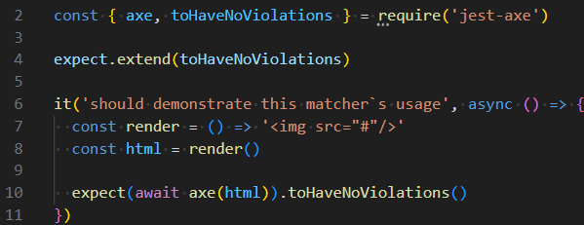
How to use Jest-axe
Once it is set up we can use it in our unit tests.

Slide 54
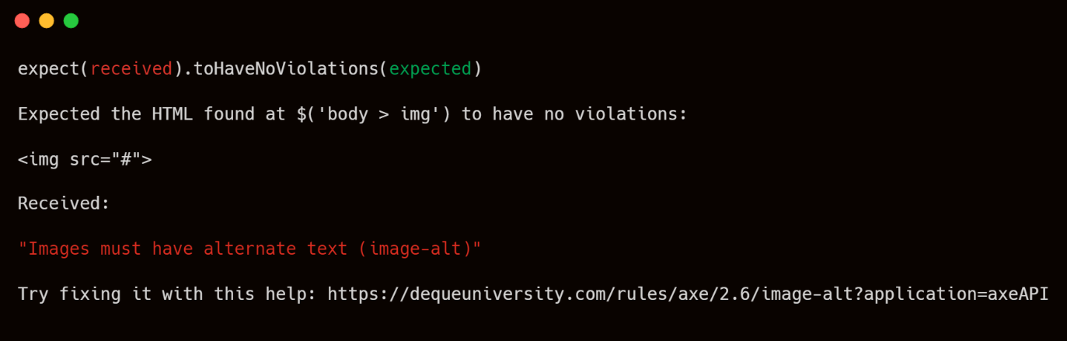
How to use Jest-axe
It will give the following error:

Slide 55
How to use Jest-axe
It can be used with any major testing framework and can be set up globally. For information how to do that please visit. https://www.npmjs.com/package/jest-axe

Slide 56
So what now?

Slide 57
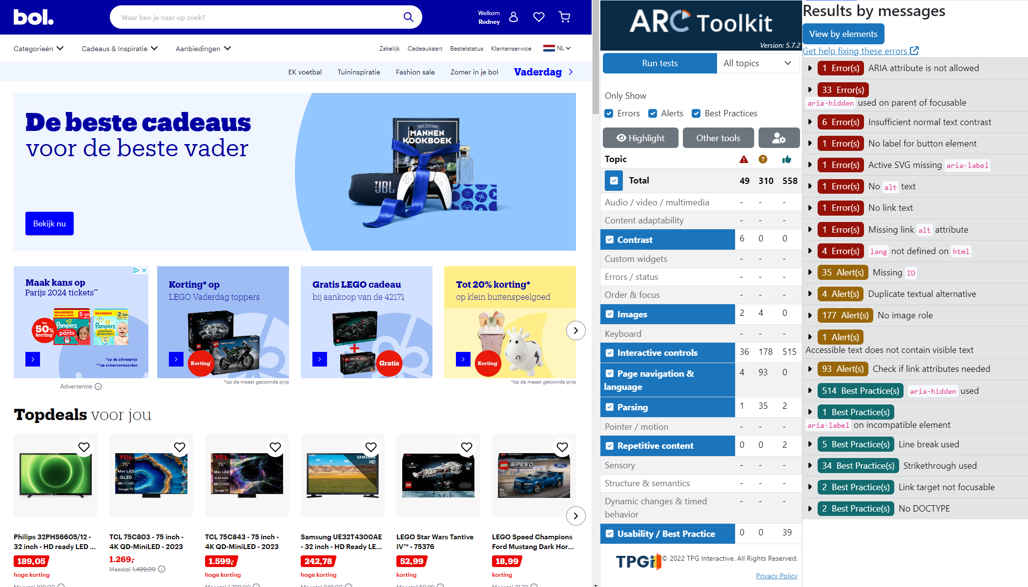
Bol.com

Slide 58
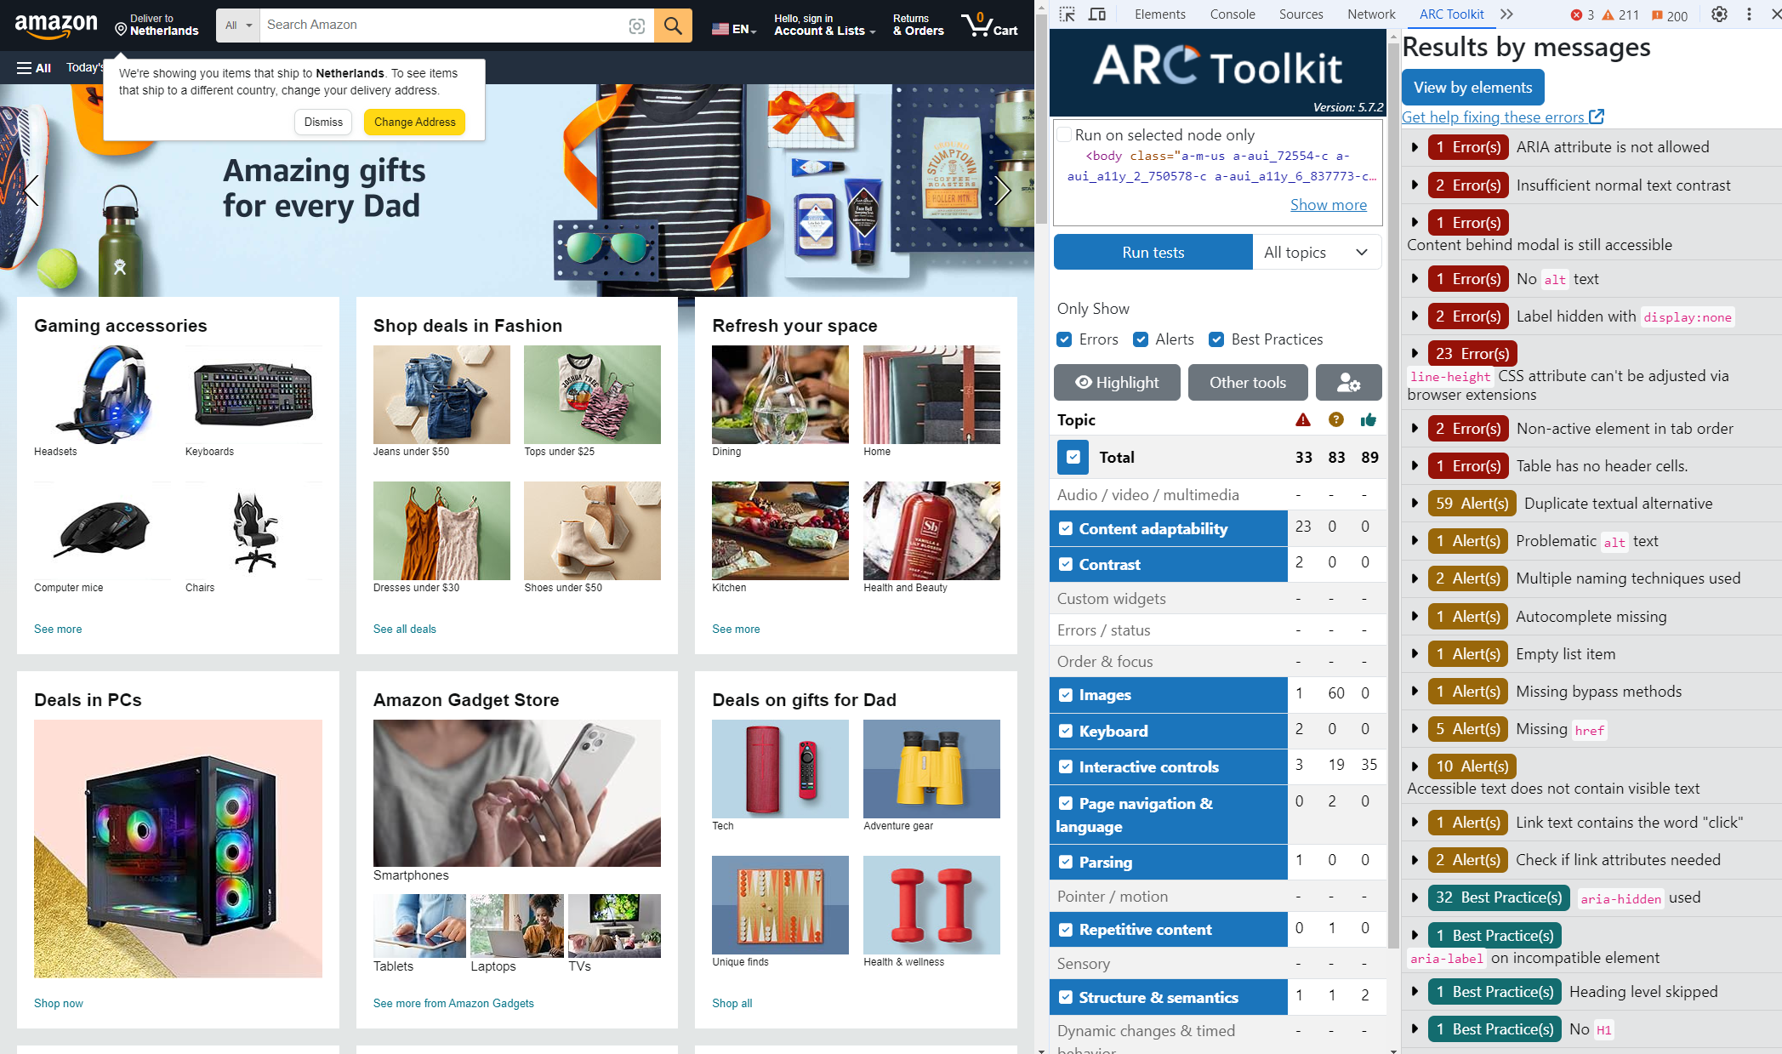
Bol.com

Slide 59
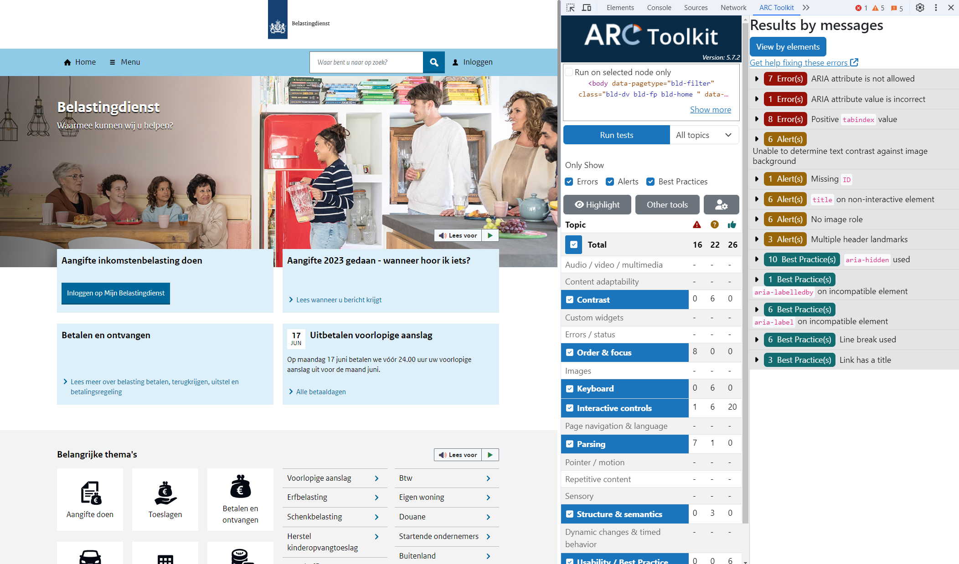
Bol.com

Slide 60
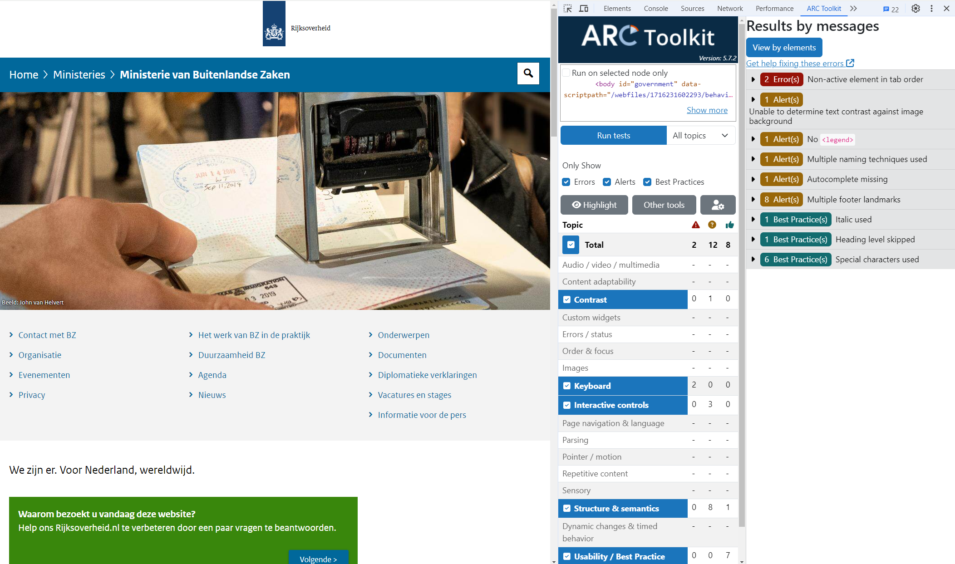
Bol.com

Slide 61
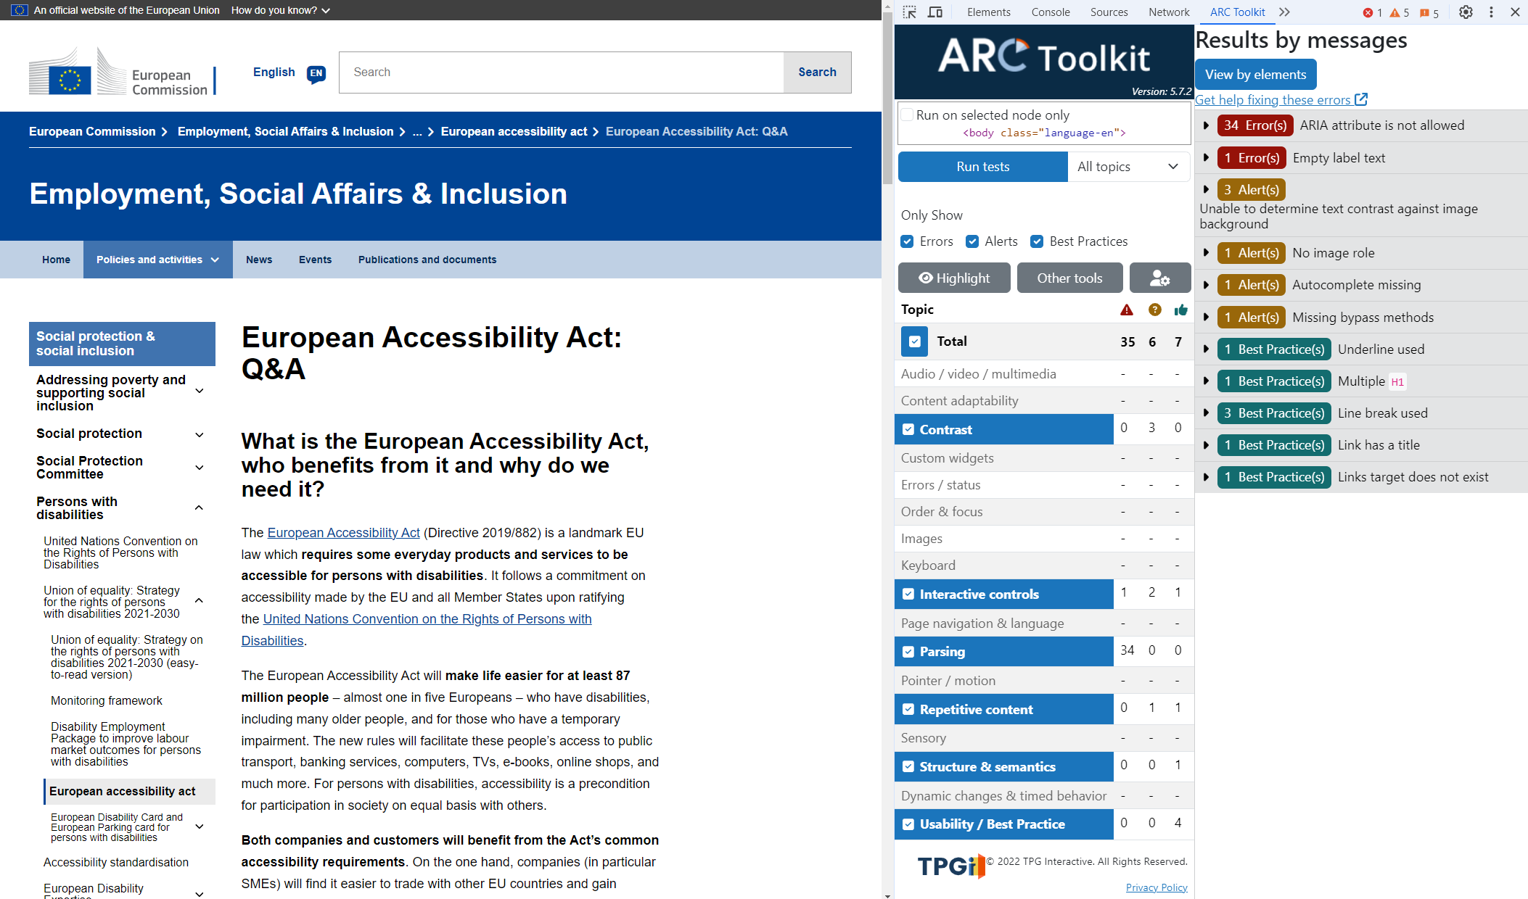
Bol.com

Slide 62
What percentage of web pages meet basic a11y
A 2023 analysis of the world’s top 1,000,000 home pages showed that a staggering 96.3% of all analyzed webpages failed to meet criteria from the Web Content Accessibility Guidelines (WCAG) 2.0 level AA, the world’s most used standard. This is down from 97.8% in 2019, or just a 1.5% decrease.

Slide 63
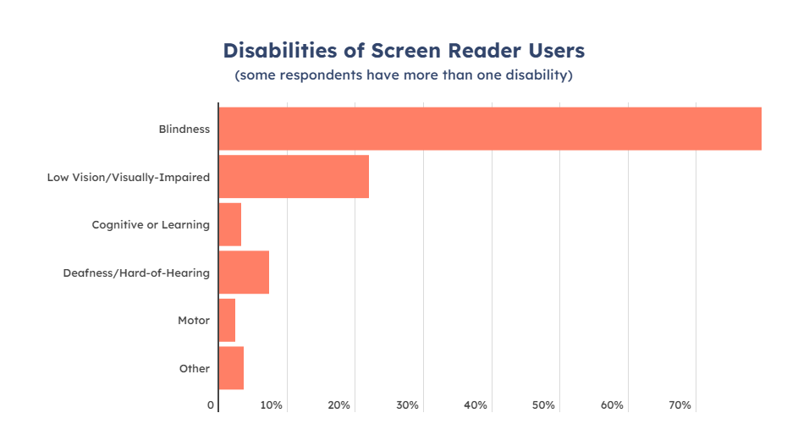
Bol.com

Slide 64
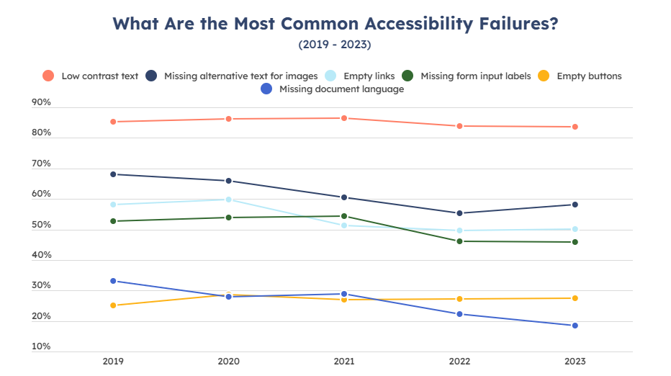
Bol.com

Slide 65
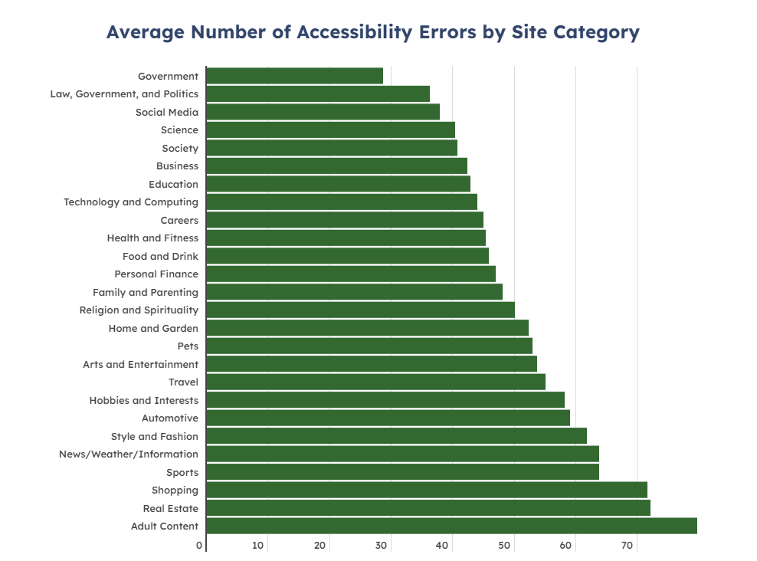
Bol.com

Slide 66

Helpful links

Slide 67
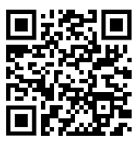
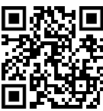
Thank you
Linkedin
Repo
Slides

